Slide 1




AIML CA2
CUSTOMER
CLUSTERING
Goh Kun Ming
DAAA/FT/1B/02
P2415691

Slide 2
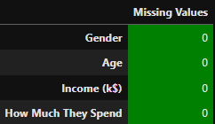
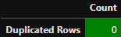
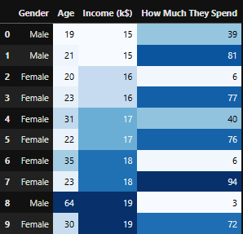
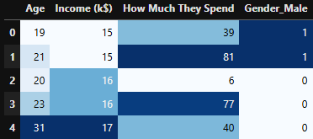
Data Cleaning and Analysis
Checking For Missing Data
Checking For Duplicated Data
Dropping Exclusive Data
Creating Dummy Variable

Slide 3
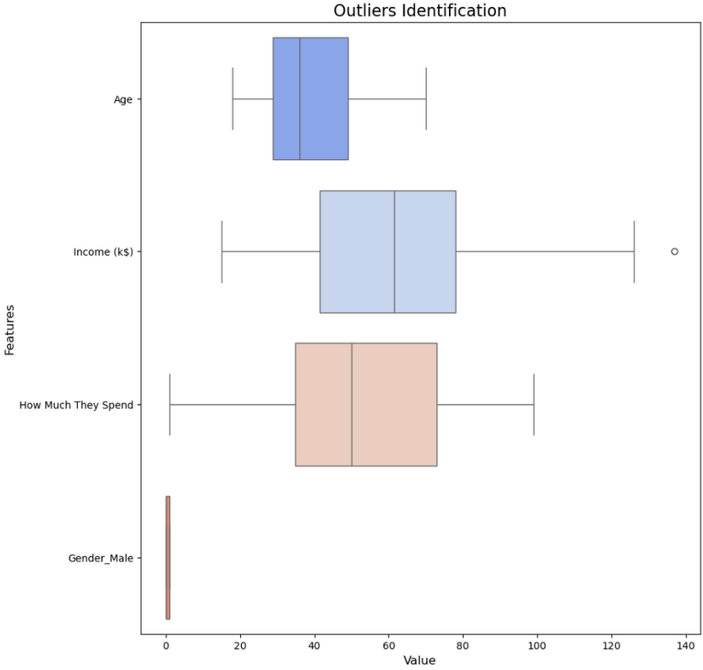
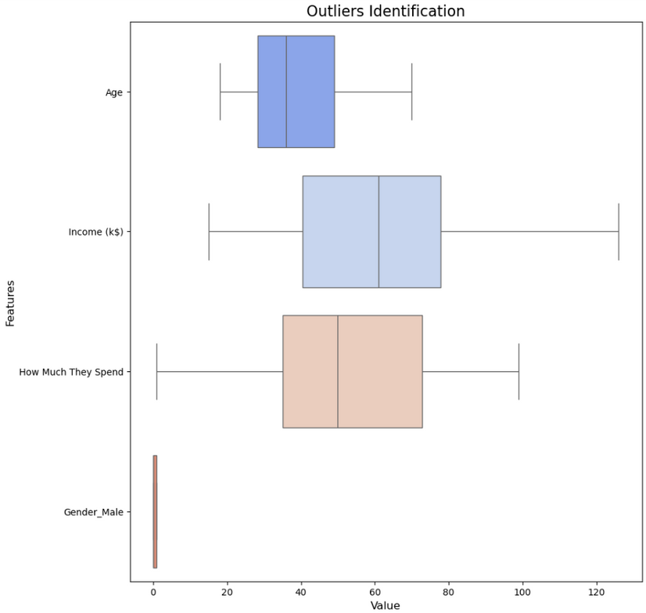
Data Cleaning and Analysis
Identifying Outliers
Removing Outliers

Slide 4
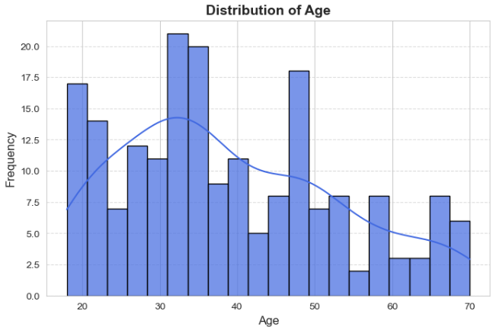
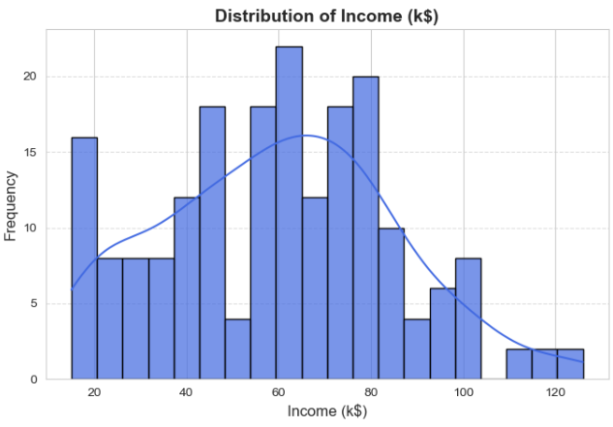
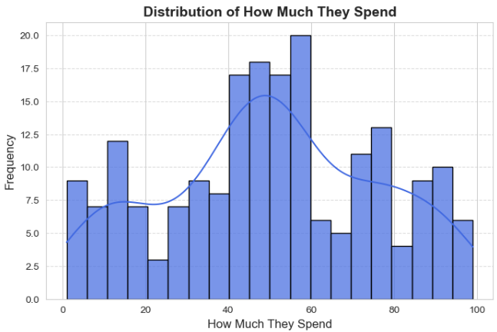
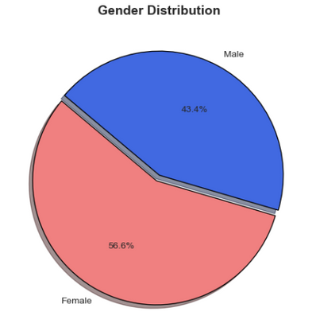
Univariate Analysis

Slide 5
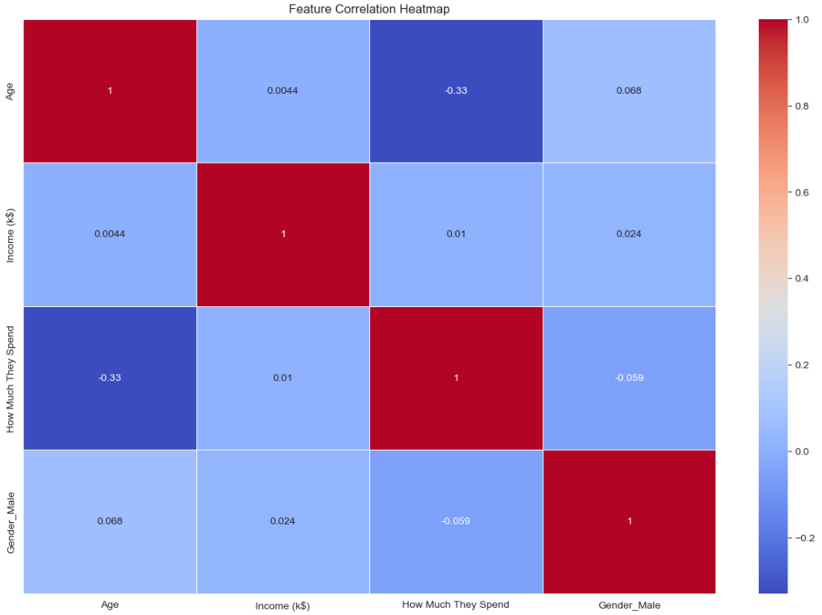
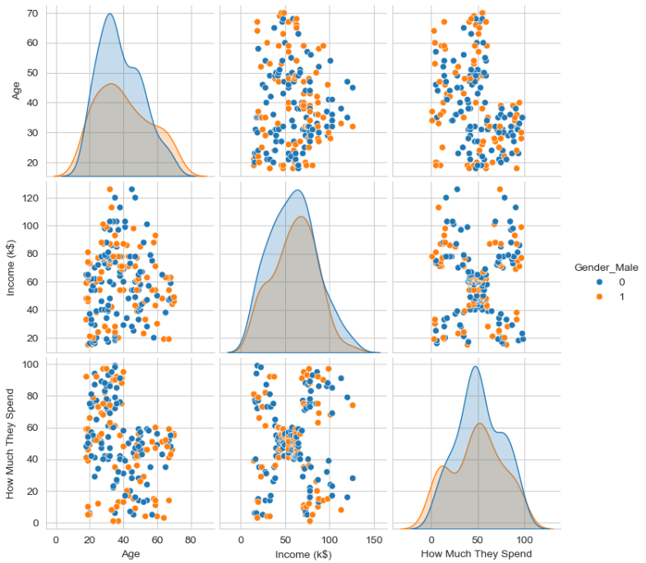
Bivariate Analysis

Slide 6
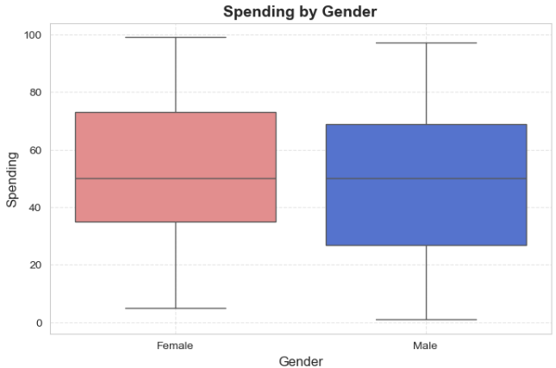
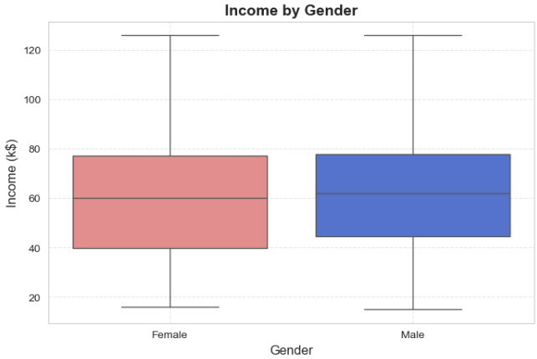
Bivariate Analysis

Slide 7
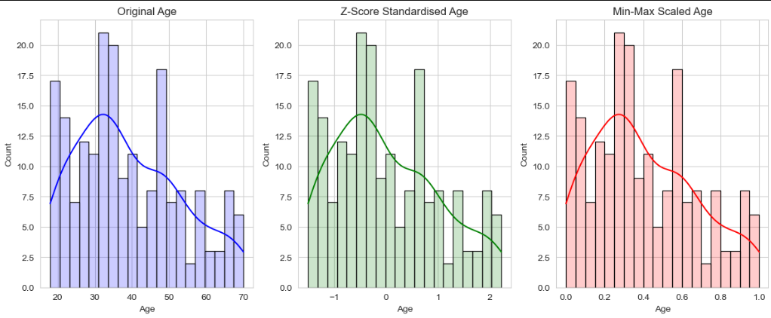
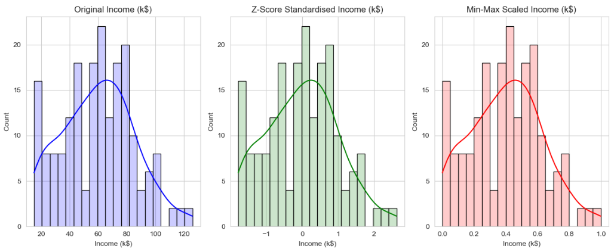
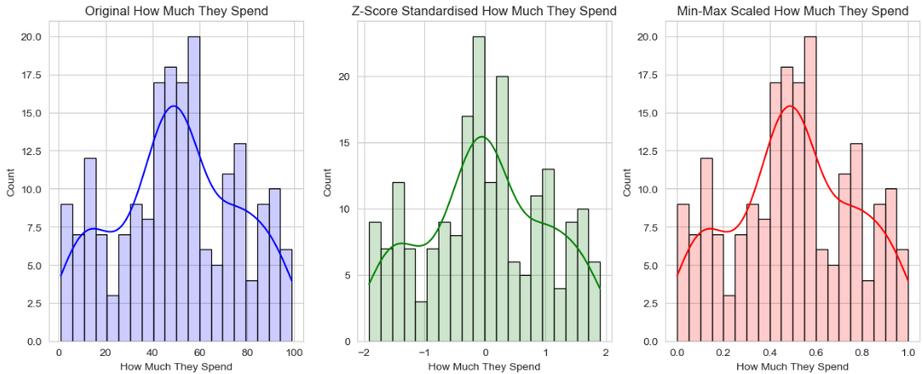
Feature Scaling

Slide 8
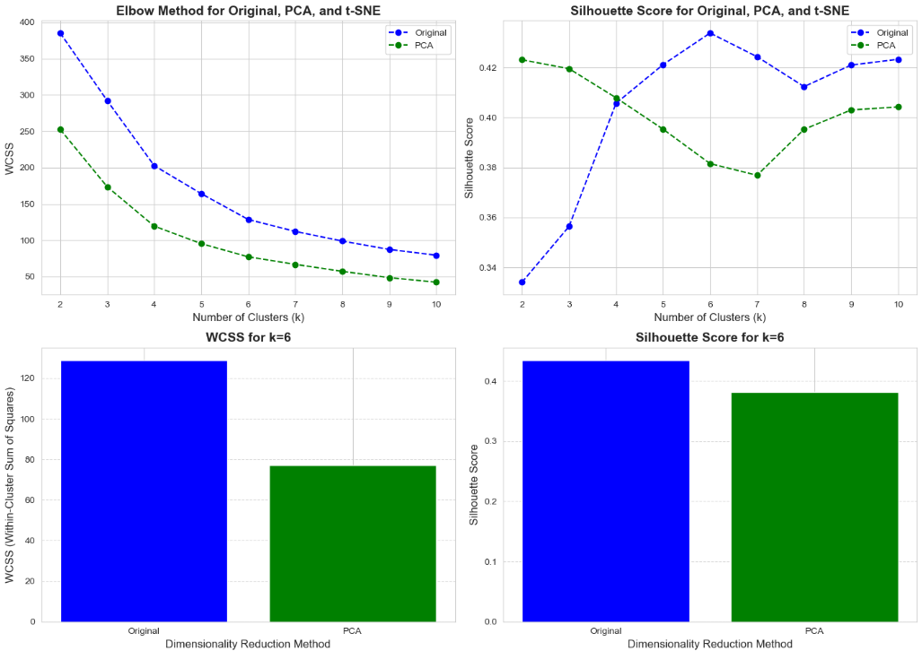
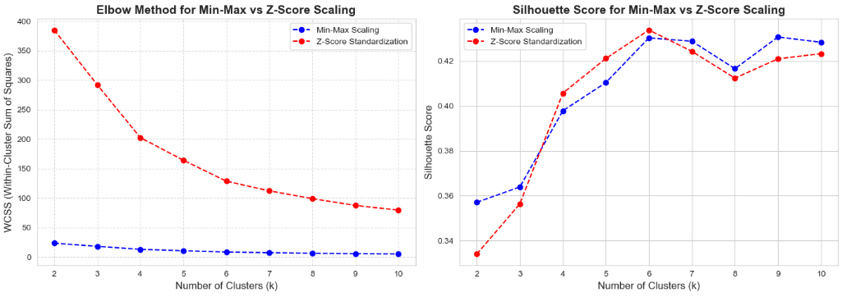
K-Means

Slide 9
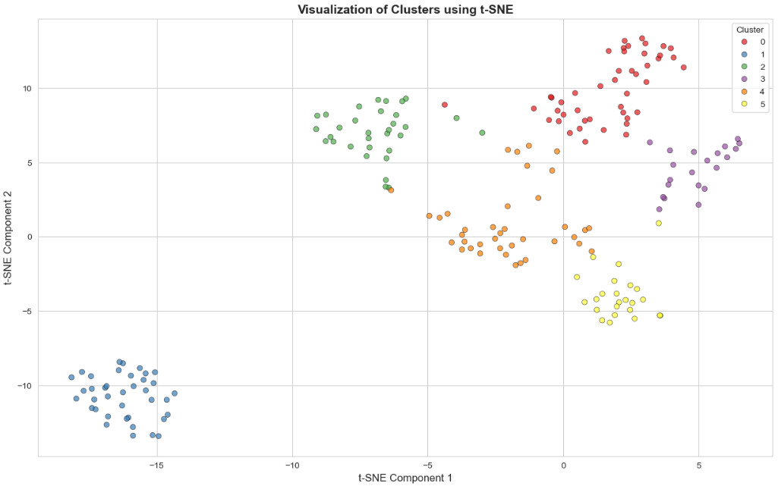
K-Means

Slide 10
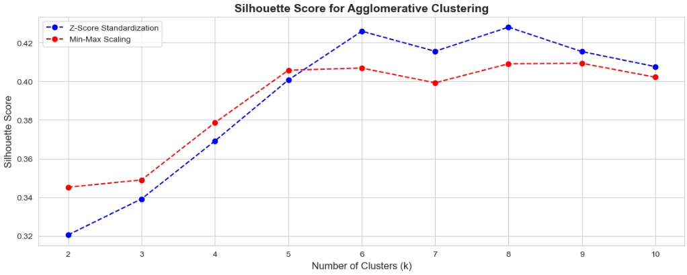
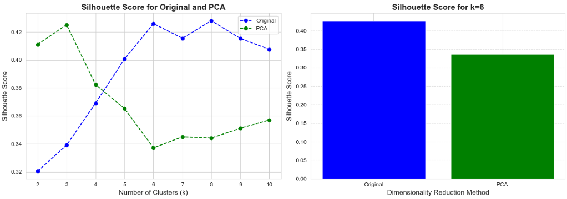
Agglomerative Clustering

Slide 11
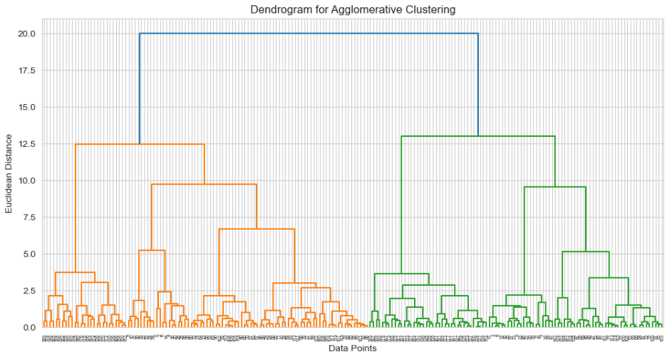
Agglomerative Clustering

Slide 12
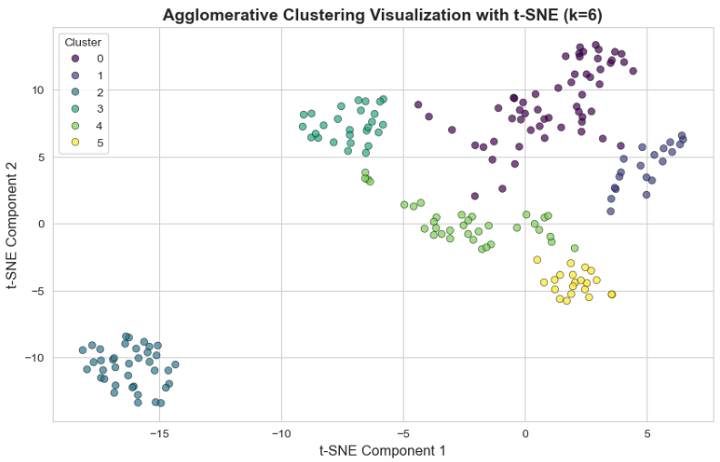
Agglomerative Clustering

Slide 13
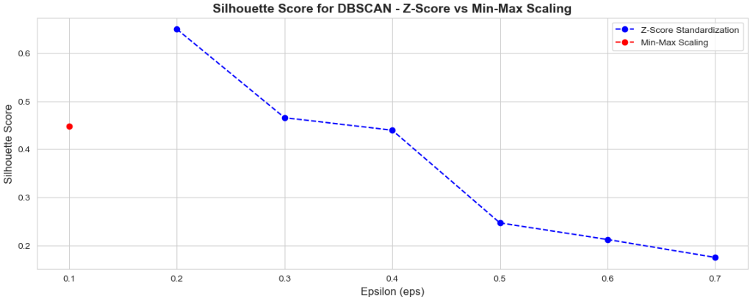
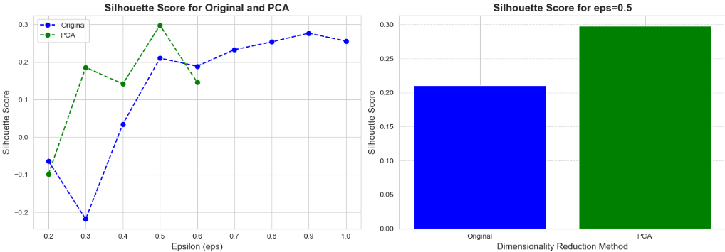
DBSCAN

Slide 14
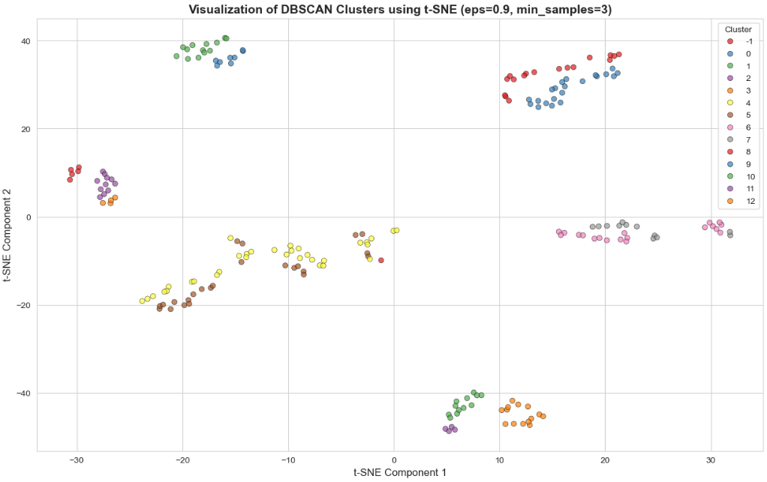
DBSCAN

Slide 15
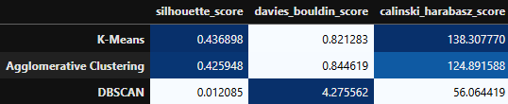
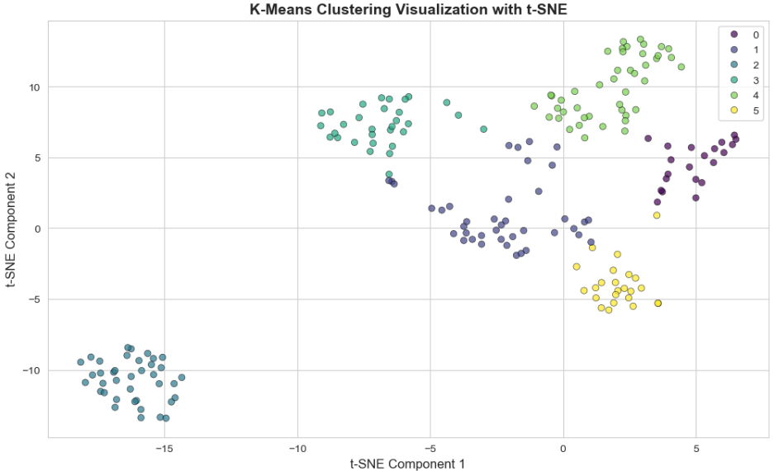
Model Evaluation

Slide 16
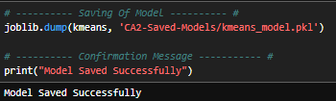
Saving of Model

Slide 17
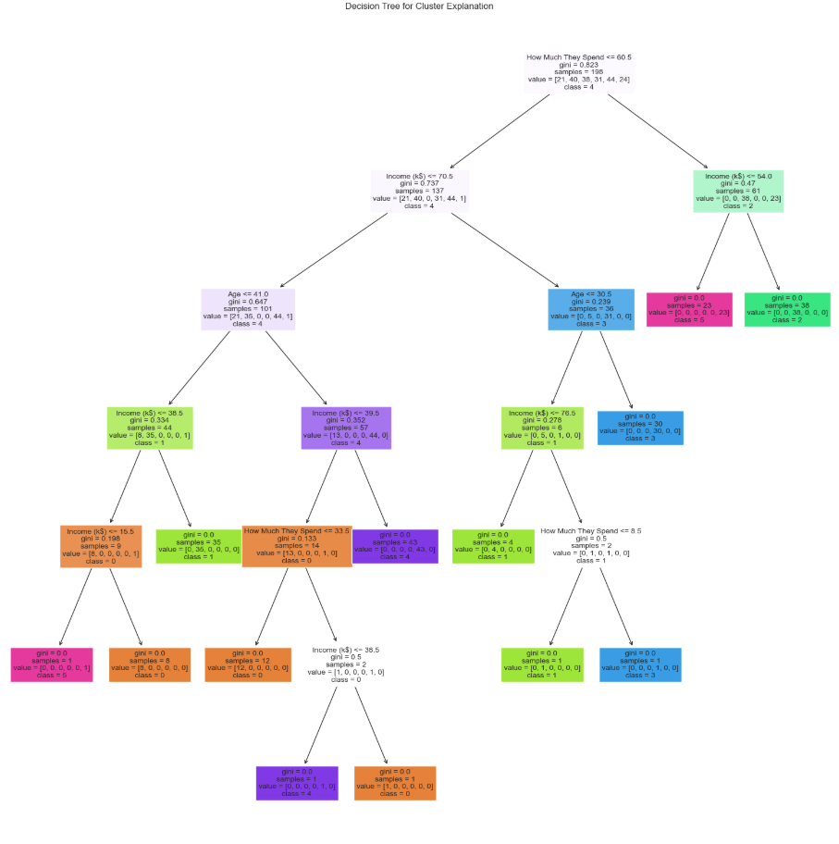
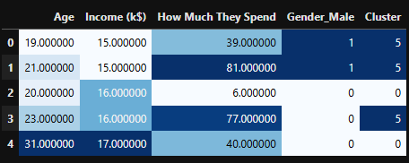
Interpretation
Reverse Scaling
Cluster 0: Lowest Income-Group With Lowest Spending
Cluster 1: Younger Demographic With Moderate Income With Moderate Spending
Cluster 2: High Income And High Spending
Cluster 3: High Income Group With Low Spending
Cluster 4: Older Demographic With Moderate Income And Moderate Spending
Cluster 5: Low Income With High Spending

Slide 18
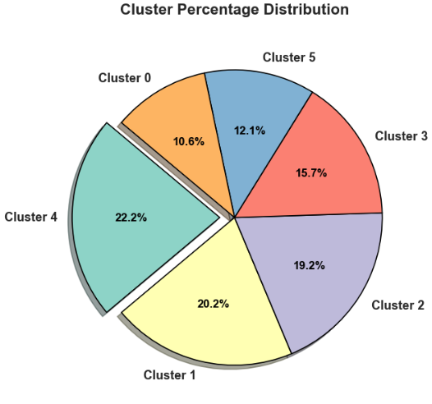
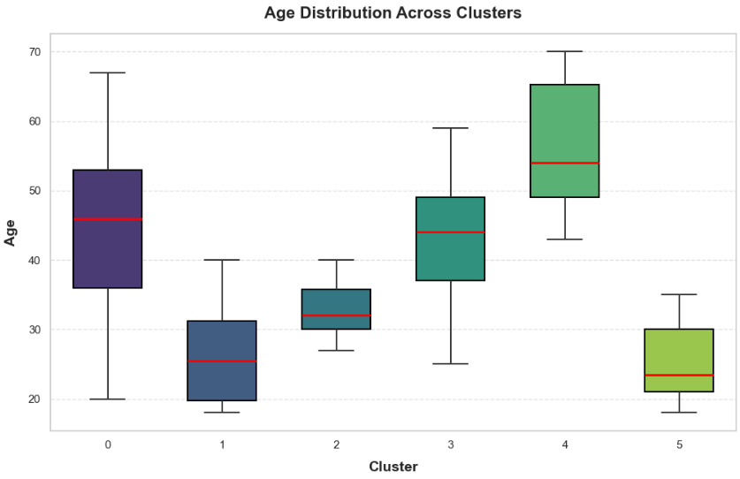
Implications

Slide 19
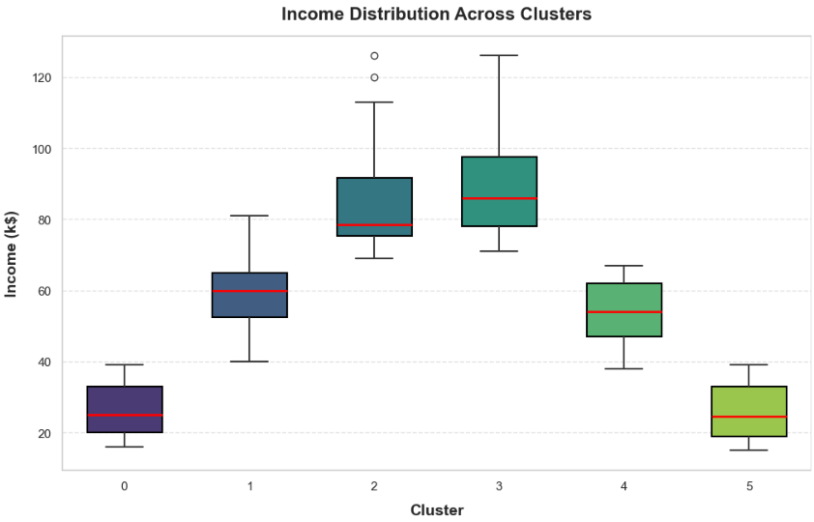
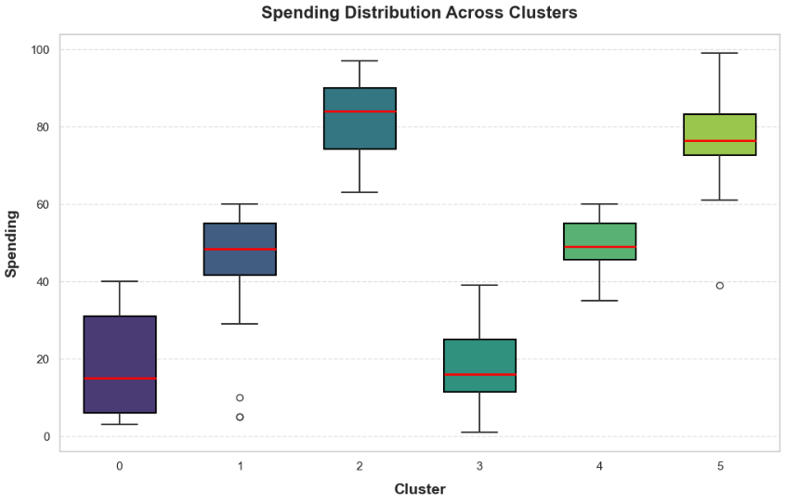
Implications

Slide 20

AIML CA 2
THANK YOU
FOR YOUR ATTENTION
Goh Kun Ming

